Slide 1

January – June 2011
Biannual Economic and
Capacity Survey

Slide 2
Firm distribution based on Annual Turnover based on responses received
January – June 2011
July – December 2010
Category by gross annual income | % of firms
0 – R1,5m | 10.4%
R1,5m – R11,5m | 39.5%
> R11,5m | 50.0%
Total | 100.0%
Category by gross annual income | % of firms
0 – R1,5m | 7.8%
R1,5m – R11,5m | 29.7%
> R11,5m | 62.5%
Total | 100.0%

Slide 3
Economic Impact
CESA Membership earnings % of GDP
Source: RBQN, CESA BECS, Industry Insight

Slide 4
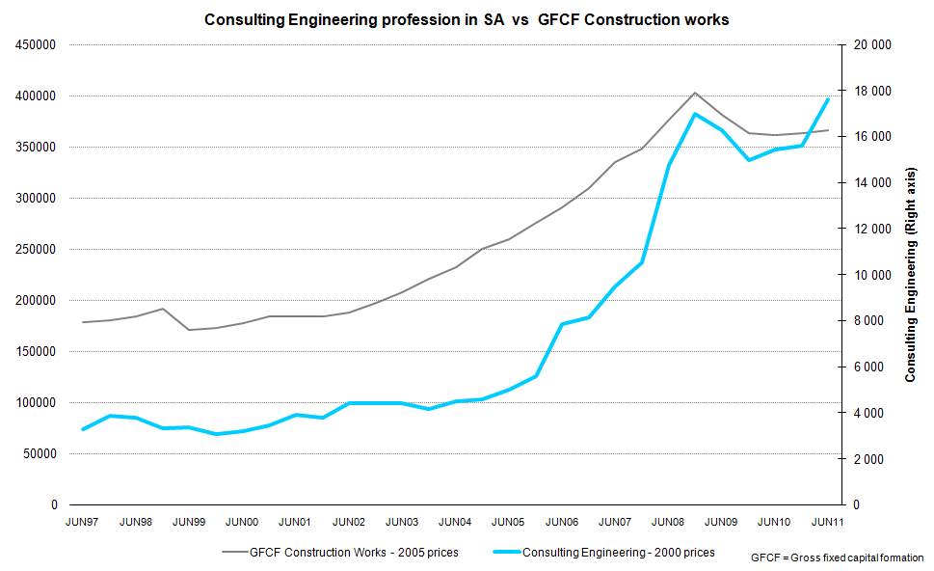
Relationship to Gross Fixed Capital Formation
Source: RBQN, CESA BECS, Industry Insight

Slide 5
Consulting Engineering Industry
Fee income, Rm Constant 2000 prices (CPI Deflated) Annualised
Source: CESA BECS

Slide 6
Consulting Engineering Industry
Real Fee income (CPI deflated), 2000 prices: Annual Change
Source: CESA BECS

Slide 7
CESA Confidence Index
Source: CESA BECS

Slide 8
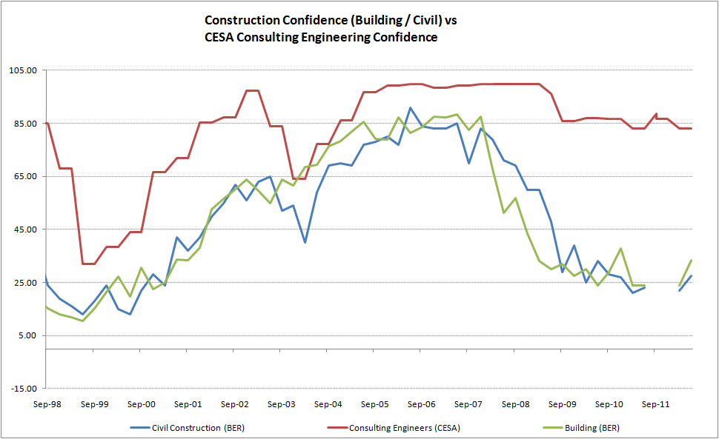
Industry Confidence
Source: CESA BECS, BER

Slide 9
Consulting Engineering Industry
Real Fee income (CPI deflated) vs confidence
Source: CESA BECS

Slide 10
Consulting Engineering Industry
Nominal Fee income vs confidence
Source: CESA BECS

Slide 11
CESA Labour Cost Indicator: Y-Y Change
Source: CESA BECS

Slide 12
Consulting Engineering Industry
Employment vs REAL fee income (CPI / LCI Deflated)
Source: CESA BECS

Slide 13
Consulting Engineering Industry
Employment vs Salary / Wage bill
Source: CESA BECS

Slide 14
Discounting
Question:
What is the prevailing discount being offered in a tendering situation to clients by your firm, benchmarked against the ECSA Guideline Fee Scales?
39% of firms
discounted by 20% or more
Source: CESA BECS

Slide 15
Fee income earned by Sub-disciplines: % Share
June 2011
Question:
What type of work did your company engage in during the past 6 months?
Source: CESA BECS

Slide 16
Fee income earned by Sub-disciplines: % Share
Change in the last 12 months
Source: CESA BECS

Slide 17
Fee income earned by Top four disciplines: R mill 2000 prices
Annual average: 2002 – 2010
Source: CESA BECS

Slide 18
Fee income earned by economic sector
Percentage market share December 2009 – June 2011
Income distribution per economic sector
Source: CESA BECS

Slide 19
Fee earnings by selected sector
Smoothed |2 survey average
Source: CESA BECS

Slide 20
Fee earnings by sector
Rm Constant prices
Source: CESA BECS

Slide 21
Fee income earned by key economic sectors
June 2005 – June 2011
Source: CESA BECS

Slide 22
Provincial Market Share: June 2011
Vs change in market share from June 2011
Income distribution per province
GAIN
market share
Source: CESA BECS

Slide 23
Fee income earned by province
High Capacity economies |Annualised smoothed
Income distribution per province
Source: CESA BECS

Slide 24
Fee income earned (Constant 2000 prices)
High Capacity vs lower capacity provincial economies |Smoothed
Income distribution per province
83% of fees were earned in high capacity provinces
Source: CESA BECS

Slide 25
Fee income earned : RSA vs EX-RSA
R mill, 2000 prices | Annualised, smoothed
Income distribution per province
87% of fees were earned in South Africa
Source: CESA BECS

Slide 26
Fee income earned by type of client
% Share – January – June 2011
Local (SA) Income distribution per fee paying client type, during the past 6 months
Source: CESA BECS

Slide 27
Fee income earned by type of client
% Share
Local (SA) Income distribution per fee paying client type, during the past 6 months
Source: CESA BECS

Slide 28
Fee income earned by type of client
R mill 2000 prices | Annualised, smoothed - avg over 2 survey periods
Local (SA) Income distribution per fee paying client type, during the past 6 months
Source: CESA BECS

Slide 29
Fee income earned by type of client
Constant 2000 prices | Annualised, smoothed - average over 2 survey periods
Local (SA) Income distribution per fee paying client type, during the past 6 months
Source: CESA BECS

Slide 30
Competition in tendering
During January – June 2011 competition for work was (Tick selection)
Source: CESA BECS

Slide 31
Competition in tendering
During January – June 2011 competition for work was (Tick selection)
Source: CESA BECS

Slide 32
% of Firms wanting to increase staff
Source: CESA BECS
New June 2005 survey

Slide 33
Engineering Skills Shortfall
% Experiencing difficulties
Fewer firms want to increase engineers
Source: CESA BECS

Slide 34
Engineering Skills Shortfall
Source: CESA BECS

Slide 35
Recruitment problems
Source: CESA BECS

Slide 36
Bursaries
% of Salary / Wage bill
Source: CESA BECS

Slide 37
Bursaries
R mill 2000 prices (Annualised)
Source: CESA BECS

Slide 38
Training (Salaries and Direct Training Costs)
% of Payroll
Data not available
Data not available
Source: CESA BECS

Slide 39
Training (Salaries and Direct Training Costs)
Rand millions, Constant 2000 prices
Data not available
Data not available
Source: CESA BECS

Slide 40
Training (Direct costs)
% of Payroll
Source: CESA BECS

Slide 41
Training (Direct costs)
Rand millions, Constant 2000 prices
Source: CESA BECS

Slide 42
Industry Capacity Utilisation
Of existing technical staff
Source: CESA BECS

Slide 43
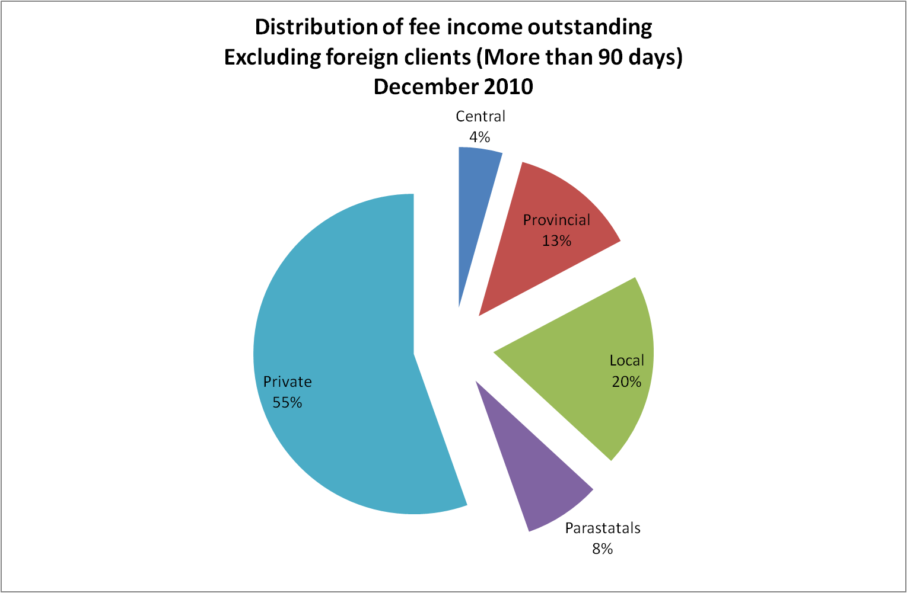
Fee income outstanding for longer than 90 days
December 2010
Source: CESA BECS

Slide 44
Total fee income outstanding for longer than 90 days
% of total fee income earned
Including foreign clients
Source: CESA BECS

Slide 45
Change in late payments, by client (Current prices)
June 2011 vs December 2010
1300% (original input) / 177% (revised input)
Source: CESA BECS

Slide 46
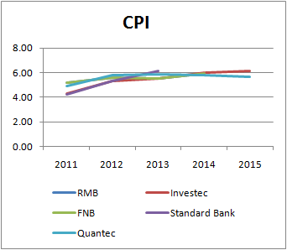
Escalation trends
Year-on-Year % Change
Based on headline consumer inflation (CPI)
Forecasts Industry Insight Economist Poll
CPI Basket Revised in January 2009
Source: CESA BECS

Slide 47
Consulting Engineering Profession
Labour unit cost indicator: Year-on-Year % Change (Smoothed)
Source: CESA BECS

Slide 48
Consulting Engineering Profession
Labour unit cost indicator: Annual Average Y-Y Chg
Source: CESA BECS

Slide 49
Typical Employment Breakdown
January – June 2011
Source: CESA BECS

Slide 50
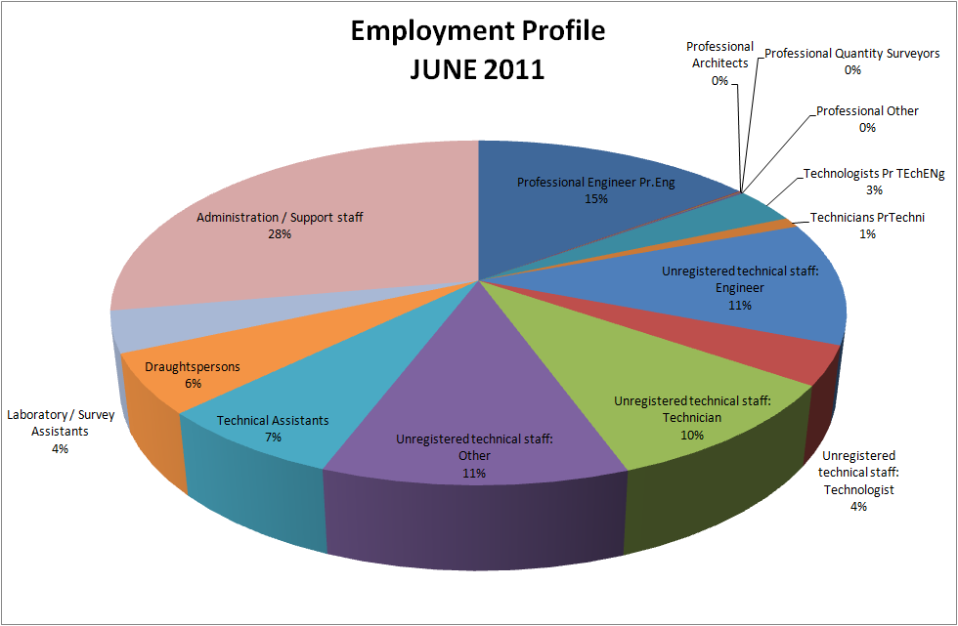
Typical Employment profile: June 2011
Total employment 19 937
Source: CESA BECS

Slide 51
Overall Employment Breakdown, by race
December 2003 – June 2011
Source: CESA BECS

Slide 52
Employment profile: Black only (excluding Asian / Coloureds) representation of total employment
% Share of total employment
Source: CESA BECS

Slide 53
Professional Indemnity Insurance
Risk profile
Source: CESA BECS

Slide 54
Equity Distribution by firm type
Source: CESA BECS

Slide 55
Ownership / Equity: % Share of total employment
PTY, CC & Partnerships
Source: CESA BECS

Slide 56
Black Ownership / Equity: % Share of total ownership / equity
PTY, CC & Partnerships
Source: CESA BECS
Black, including Asian & Coloured

Slide 57
Women contribution to ownership and equity
% of total ownership / equity (PTY, CC and Partnerships)
Source: CESA BECS
Black including Coloured & Asian

Slide 58
Black ownership / equity
as % of total ownership / equity by type of company
December 2007 – December 2010
Black includes Asian and Coloureds
Source: CESA BECS

Slide 59
Quality Management System
Source: CESA BECS

Slide 60
ISO 9001:2008 Certificate
Source: CESA BECS

Slide 61
Thank you
www.cesa.co.za
Tel: 011 463 2022

